Slide 1
Dataset Required based on cause-effect analysis from below Paper:
{Spatial prediction of flood susceptible areas using rule based decision tree (DT) and a novel ensemble bivariate and multivariate statistical models in GIS, 2013, by Mahyat Shafapour Tehrany, Biswajeet Pradhan, Mustafa Neamah Jebur}
DEM
Curvature
Geology (Types of rocks)
Distance from River
SPI (Stream Power Index)
Rainfall
LULC
Soil Type
Topographic Wetness Index (TWI)
Slope
Temperature (additional, may be considered)
Limitation: Papers generally provide details of flood susceptible areas and I am yet to find any model which can pin-point the flood area (early warning)
Based on some Literature survey, the following paper felt good to follow (search keywords: spatial flood prediction; spatial flood prediction based on stream flows)
Paper Name | Year | Link | Datasets Used
Spatial prediction of flood susceptible areas using rule based decision tree (DT) and a novel ensemble bivariate and multivariate statistical models in GIS | 2013 | https://doi.org/10.1080/10106049.2019.1687594 | Flood inventory map with a total of 155 flood locations. The spatial database includes digital elevation model (DEM), curvature, geology, river, stream power index (SPI), rainfall, land use/cover (LULC), soil type, topographic wetness index (TWI) and slope.

Slide 2
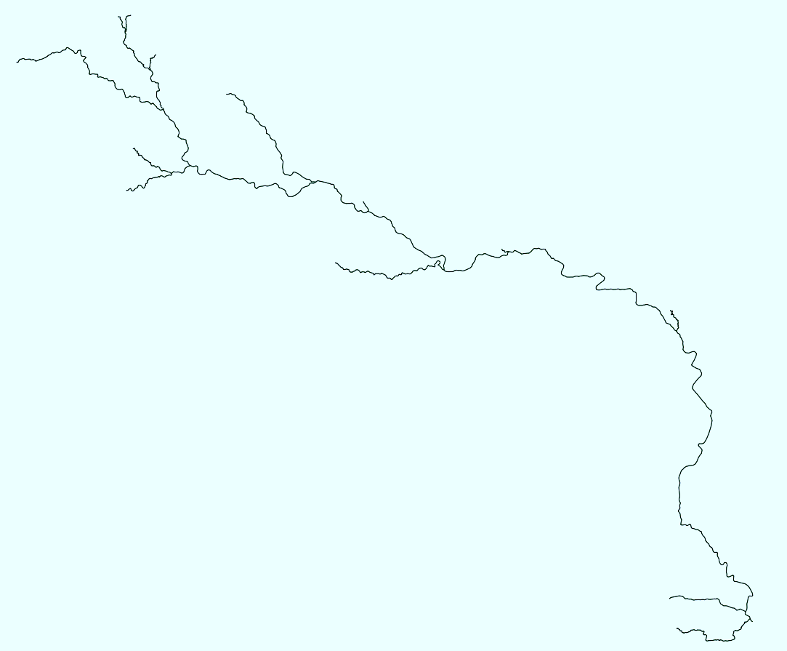
Available Data
Required Data for common Area of Interest
Required Static Data of the entire watershed (concerned basins):
DEM
LULC
Slope
Topographic Wetness Index (TWI) / Soil Type
Bathymetry
Stream Ordering
Required Dynamic data (spacio-temporal):
Rainfall (available only from Ghatal as below)
Hydro-Gauge data for river levels and flows
Stream Data of the entire Watershed concerned (best if converted in raster):
Another requirement is to identify drought affected areas in the same or surrounding watersheds….

Slide 3
Some Resources
Stream Order - River Network Using DEM Map in ArcGIS – GISRSStudy
obtain stream ordering for indian rivers - Search (bing.com)
HAZARD ATLAS OF INDIA (imdpune.gov.in)
wris_time_series_data - INDIA WRIS WIKI
River discharge data are now available online | GCOS (wmo.int)
India-WRIS (indiawris.gov.in)
Hydrological Data | Central Water Commission, Ministry of jal shakti, Department of Water Resources, River Development and Ganga Rejuvenation, GoI (cwc.gov.in)
spatial flood prediction - Google Scholar
SubInfoSysLCC/River_StreamOrder (MapServer) (indiawris.gov.in)
ganga - INDIA WRIS WIKI
MIS WIMS (india-water.gov.in)
Water crisis in India’s Maharashtra | India News | WION Climate Tracker - Bing video
Flood Forecast - Central Water Commision, Govt. Of India (india-water.gov.in)
pib.gov.in/PressReleaseIframePage.aspx?PRID=1849954
Repository search results (github.com)
Water Resources | Sector | Open Government Data (OGD) Platform India
HAZARD ATLAS OF INDIA (imdpune.gov.in)

Slide 4
Papers
Quantitative assessment of check dam system impacts on catchment flood characteristics – a case in hilly and gully area of the Loess Plateau, China | SpringerLink
Priority-flood: An optimal depression-filling and watershed-labeling algorithm for digital elevation models - ScienceDirect
Historical Data:
Annual Flood Reports

